Slide 1

RAJIV GANDHI UNIVERSITY rono hills, doimukh arunachal pradesh
PROJECT PRESENTATION ON:- TOURISM AND TRAVELS DATABASE MANAGEMENT SYSTEM
PROJECT GUIDE:- Bhaskar Jyoti
Submitted by
Ajay Prajapati(15BCA002)
Taba nunu(15BCA011)

Slide 2
CONTENTS
Introduction
Modules Of Tourism And Travel
Database Management System
ER-diagram
UML Diagram
Data Dictionary
Input Design
i . Registration
ii. Admin Login
iii. Admin Home
Future Enhancement

Slide 3

Introduction
The tourism and travels management system is a web based application.
The main purpose is to provide convenient way for a customer to book hotels, etc.
In this project, we will make an easier task of searching place and for booking train, flights, bus, etc.
it will help to replace the old manual.

Slide 4
Modules Of Travels And Tour Management System
1. Admin Module
a. Manage User Information
b. Update Information
c. Manage Bookings
d. Manage Payment
2. User Module
a. Login/Register
b. User Profile
c. Update Information
3. Hotel Module
a. Registration (as user)
b. Registration (as hotel)
4. Transport Module
a. Flight
b. Train
c. bus etc...

Slide 5
Modules Of Travels And Tour Management System
5. Payment Module
a. Pay Payment Through Cash
b. Pay Payment Through Online Banking
6. Routes Module
a. This Will Display The Routes Information Of Source Location And Destination Location.
7. Feedback Module
a. Reviews (Through Email)

Slide 6
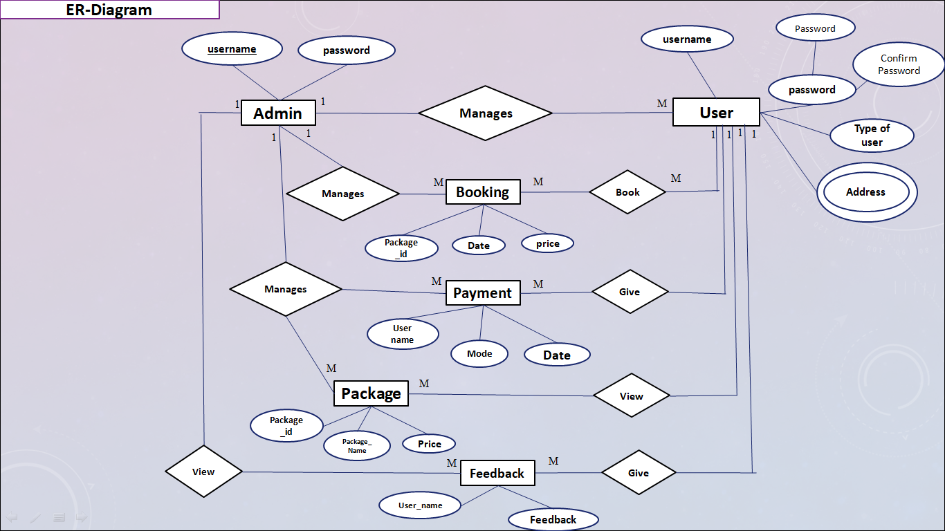

Slide 7
UML Diagram
Registration
Login
Manage User
Manage Package
Manage Booking’s
Admin
Manage Payment
View Feedback

Slide 8
Data Dictionary
1. Table Name: Adduser
Description: To store the admin, Users Login Details
Primary Key: User Name
Sr. No | Name | Data Type | Constraint | Description
1 | Username | Varchar (50) | Primary Key | To StoreThe Username.
2 | Password | Varchar (50) | Not Null | To Store The Password.
3 | Typeofuser | Varchar(50) | Not Null | To store user type like admin , User And Guest.
4 | Address | varchar(100) | Not Null | To Store Address of The Admin , User And Guest.
5 | Mobile Number | int(11) | Not Null | To Store Mobile Number of the admin, user and Guest.
6 | Country | varchar(30) | Not Null | To Store Country name.
7 | State | varchar(50) | Not Null | To Store State name.
8 | City/Town | varchar(50) | Not Null | To Store City/Town name.
9 | Email Id | varchar(50) | Not Null | To Store Email address of the Admin, User and Guest.

Slide 9
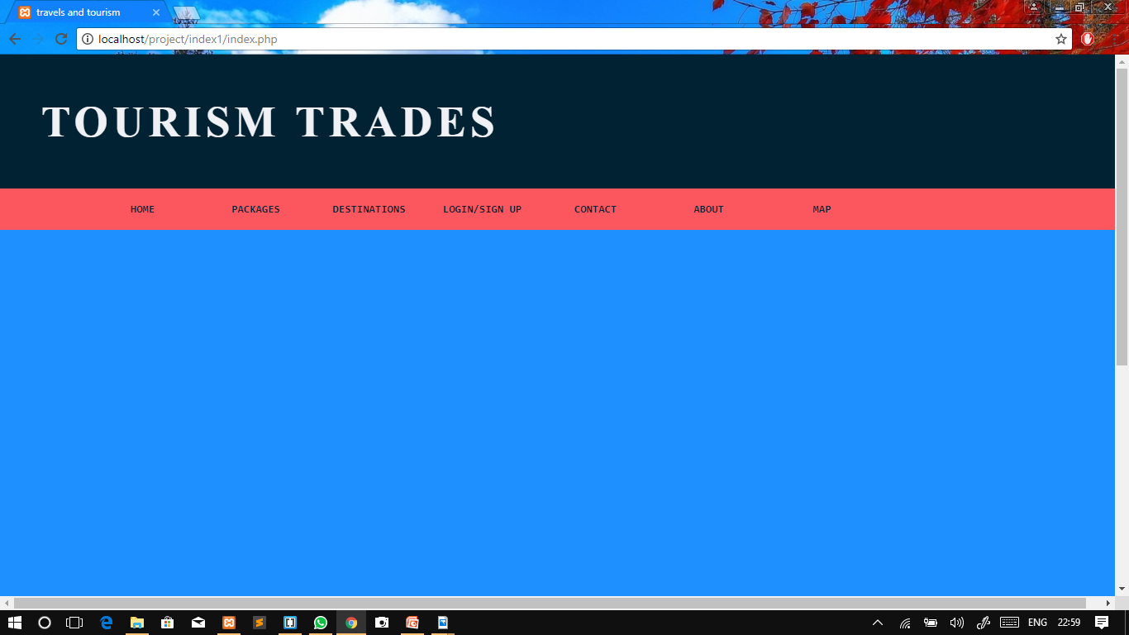
Input Design
HOME PAGE
Description: Home page of Tourism and Travel Management system.

Slide 10
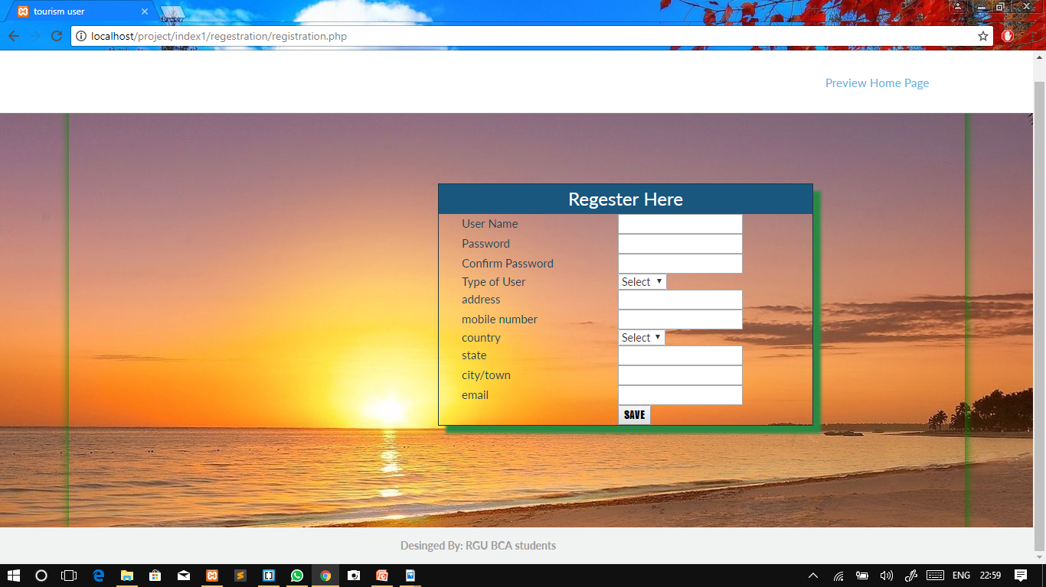
Input Design
REGISTRATION
Description: Registration page of Tourism and Travel Management system.

Slide 11
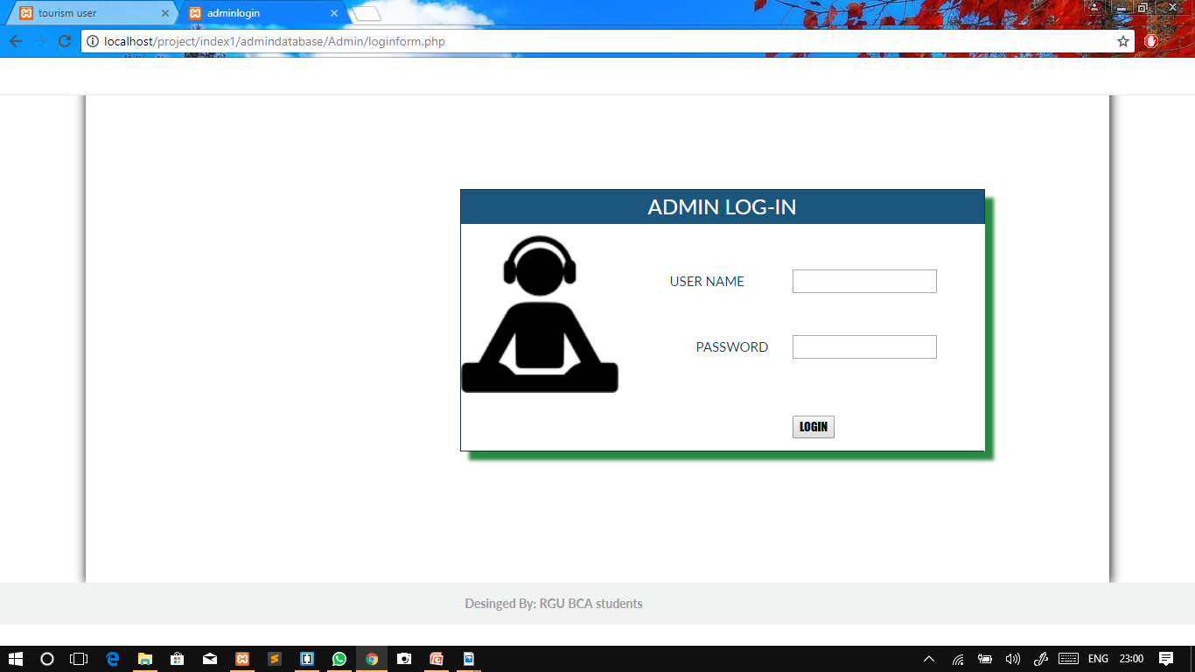
Input Design
ADMIN LOGIN
Description: Admin Login Page of Tourism and Travel Management system.

Slide 12
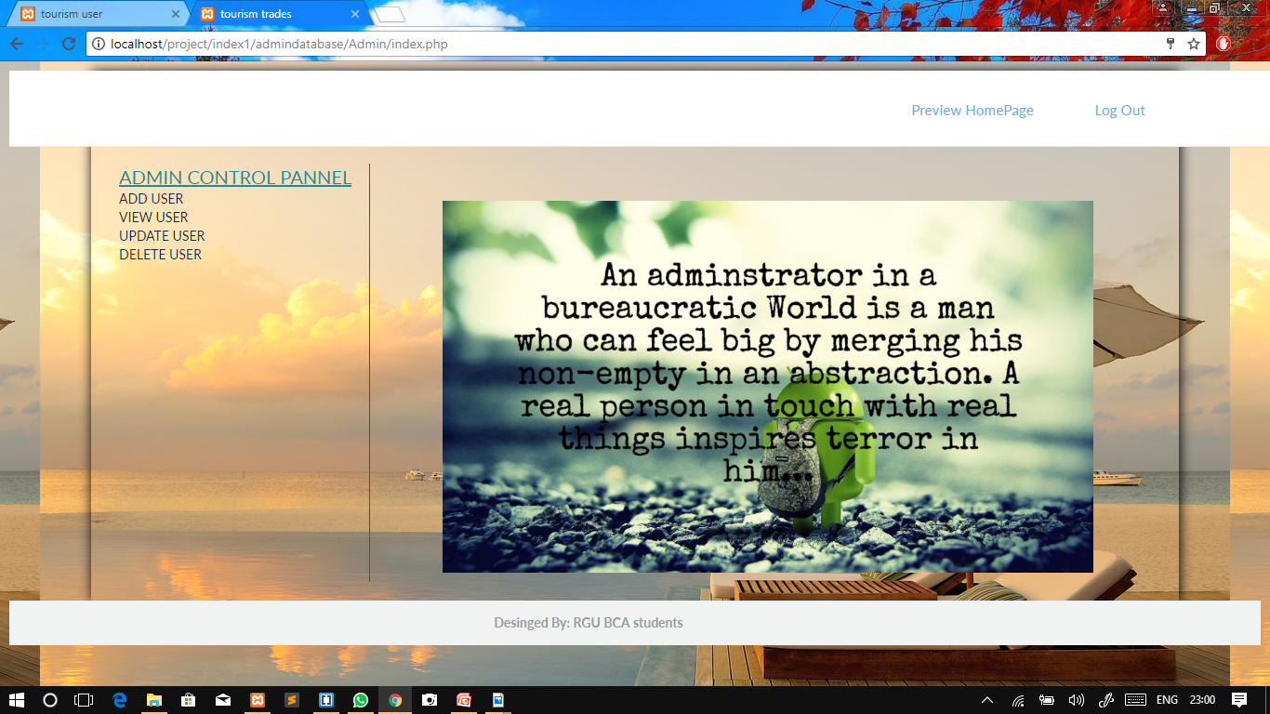
Input Design
ADMIN HOME
Description: Admin Home Page of Tourism and Travel Management system.

Slide 13
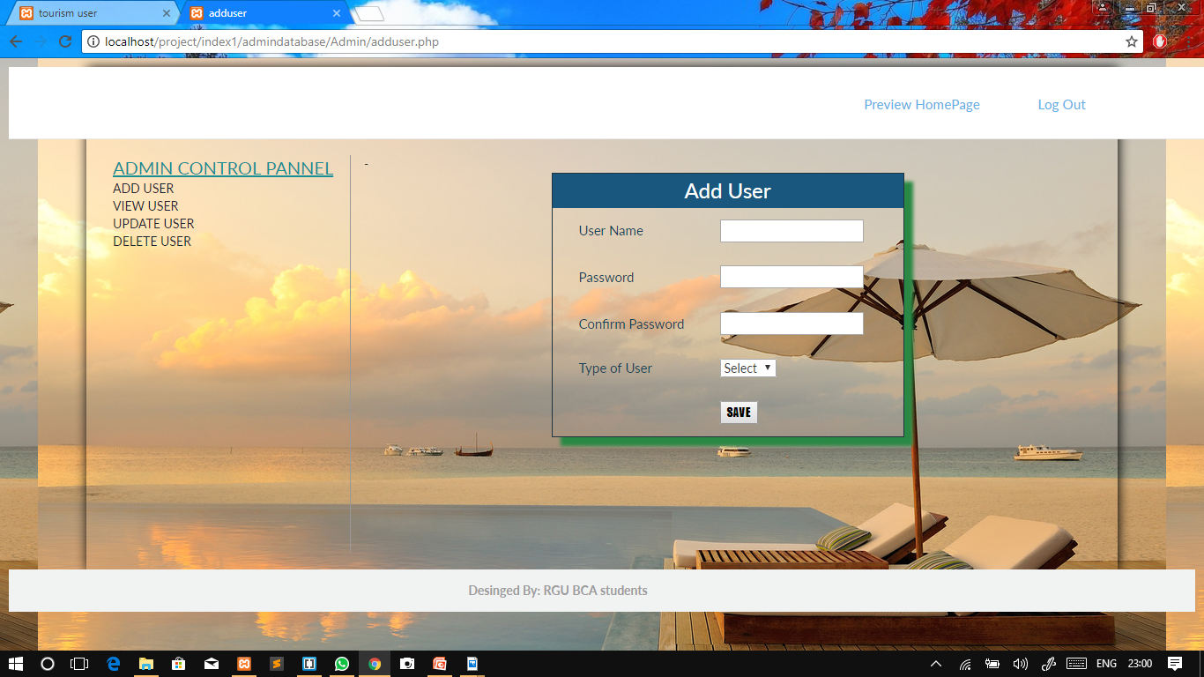
Input Design
ADDUSER
Description: Adduser Page of Tourism and Travel Management system.

Slide 14
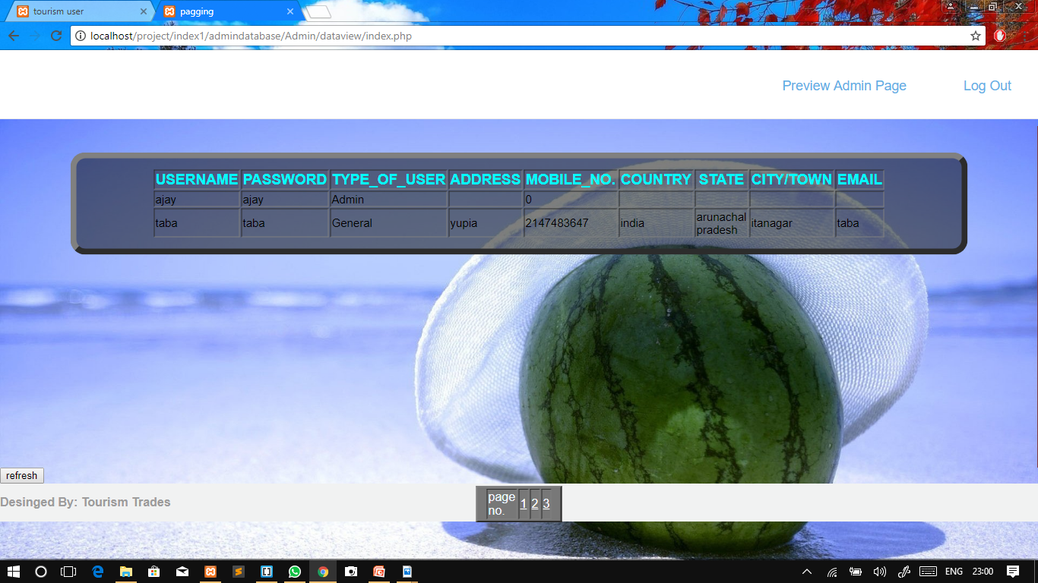
Input Design
VIEW USER
Description: View User Page of Tourism and Travel Management system.

Slide 15
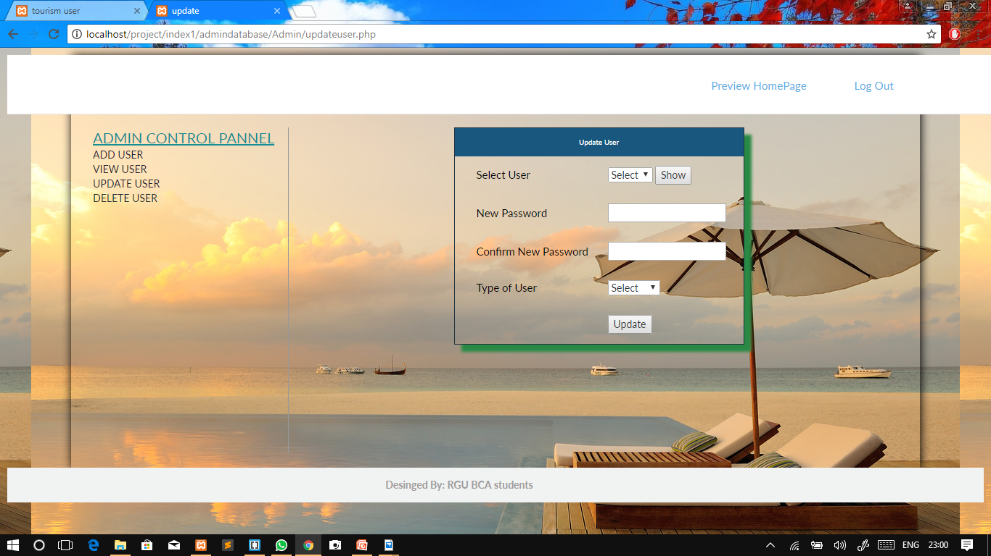
Input Design
UPDATE USER
Description: Update UserPage of Tourism and Travel Management system.

Slide 16
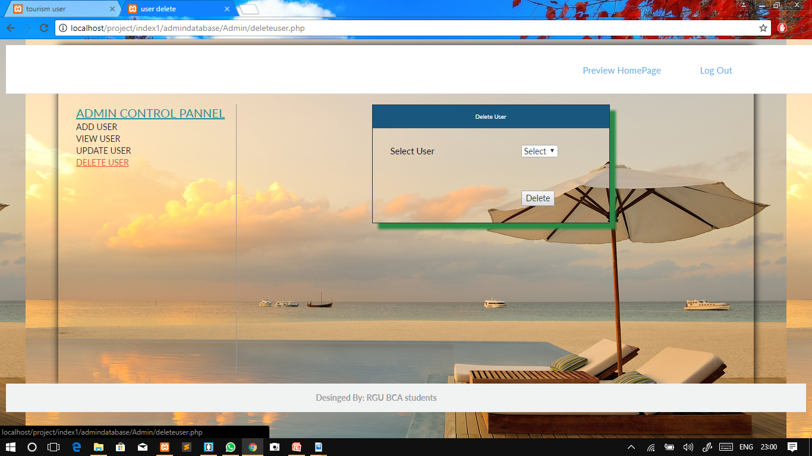
Input Design
DELETE USER
Description: Delete UserPage of Tourism and Travel Management system.

Slide 17
THANK YOU...

